Slide 1
ERO/Transmitter Training

Slide 2
Outline
Primary Duty
Responsibilities
Qualifications
Efile Process

Slide 3
Primary Duty
Electronically file Federal and State tax returns with the IRS and State tax agencies using TaxWise software after returns are Quality Reviewed and signed by the taxpayer(s)

Slide 4
Responsibilities
Establish a process to insure all returns are promptly submitted
Track status of all returns from creation to acceptance
Receive return acknowledgments
Ensure all rejects are promptly corrected and accepted or returns converted to paper

Slide 5
Responsibilities (cont)
Reporting statistical accomplishments as required
Answer questions and address anomalies that occur during return preparation and electronic filing
Do not retain any taxpayer data unless specifically authorized, i.e., associated with Form 8453

Slide 6
Qualifications
Certified as a AARP Foundation Tax-Aide Volunteer Counselor
Proficient with TaxWise Online
Have basic knowledge of personal computers, software, and electronic communication systems
Maintains close working relations with counselors, LC, TC and others on e-filing of returns. In many cases the LC is the ERO/Transmitter

Slide 7
Track Returns from Submittal to Acceptance
Use Activity Reporting, Quality Review Tracking Log -OR-
Use Return Stage -OR-
Use Paperless Tracking

Slide 8
Use Activity Reporting, Quality Review ERO Tracking Log
Use Tracking Log to track status of federal and state returns, questions asked, paper returns or pending completion
Tracking Log is available on the [OneSupport Help Center] [Portal Support][Activity Reporting][Site Activity Log Form]
Site can modify form if needed to meet local needs

Slide 9
ERO Tracking Log
Also, site may use ERO Tracking Log to indicate status of return if not ready for e-file, for example:
8879 HOLD – Waiting for second signature on Form 8879
Taxpayer HOLD – Taxpayer needs to return with additional information to complete the return, etc.

Slide 10
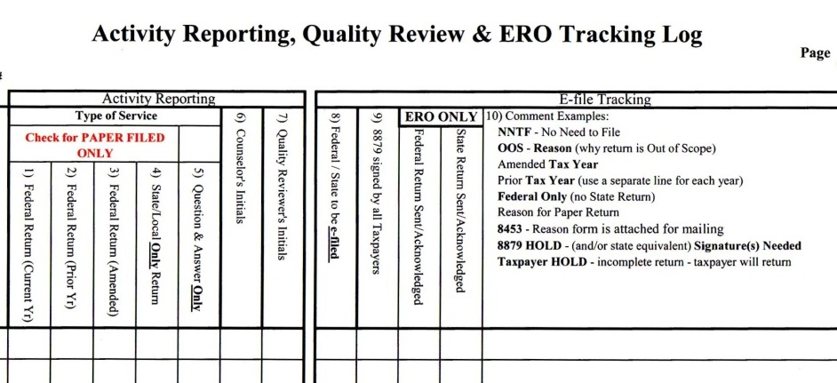
ERO Tracking Log

Slide 11
Return Stage
Helpful in tracking return status
Helpful in keeping the ERO/Transmitter informed on status of each return
All volunteers can update Return Stage each time a return is changed

Slide 12
TWO Site Paperless ERO Tracking
Efile tracking can be paperless using TWO [All Returns]
Can sort by[TIN][NAME][US e-File][State e-File][Stage] [Date][Username]
When return prepared, Quality Reviewed, e-Files created and Return Stage set, information shown in [Active Return]

Slide 13
Return Diary Information
Taxpayer Diary key for communication
Used to record information about returns (and taxpayers)
Select [Taxpayer Diary] in return and enter relevant information.
Icon by TIN on ribbons can be selected to access information. Additional information can be added.
Note: Information carries over from previous year. Can delete information in the diary as needed
Notes:
Previously MIS and Prep Use forms were used, but Diary is more convenient.

Slide 14
Diary Initiated In the Return

Slide 15
TWO Diary Information

Slide 16
E-file Process
Quality Reviewer reviews return with taxpayer and explains that taxpayer is ultimately responsible for return
Taxpayer(s) sign Form 8879
E-file created and Return Stage set [Efile – Ready to File]
Return submitted/transmitted after items 1 – 3 completed
For rejects, correct mistakes and re-transmit
If more info required from taxpayer, have original counselor, if available, contact taxpayer

Slide 17
Ensure All Intended E-file Returns Are Transmitted
Check Return Stage, set if necessary
Active Returns Window in TWO
Complete ERO Tracking Log to see that all completed returns are accounted for
Or check Active Returns log

Slide 18
Now Wait
Federal and state acceptance estimated timeframes
15 – 60 minutes – Federal returns
Time varies for State returns
Review acceptances/rejections – if using ERO Tracking Log, update
Correct rejects
Provide feedback to all counselors

Slide 19
State Returns
State returns submitted together with federal are held until federal return is accepted. Can then transmit State – Preferred
State returns can also be submitted on their own by checking [unlinked] on state return.
Note: If state accepted and federal rejected may have to amend state return

Slide 20
A Return Was Rejected!
Correct error
New Form 8879 signatures needed if :
SSN or name changed -OR-
Change in total income or AGI is $50 or more -OR-
Change in total tax, federal tax withheld, refund or amount due is more than $14

Slide 21
Rejected Return (cont)
Advise taxpayer of change and provide a corrected copy
If cannot be e-filed, convert to paper
The taxpayer must mail the return
Provide feedback to counselor, quality reviewer and LC

Slide 22
End of Season Actions
Since returns will continue to be available to preparers, to protect taxpayer information:
Move returns to the Admin user
Change all users to return preparer. Exceptions
Administrator
Select Administrator user(s) as backup
Deactivate counselors who will not be returning

Slide 23
End of Season Actions
Computers returned to custodian (AARP computers) and person receiving shipment (IRS computers)
Person who received IRS shipment must
Run WIPEDISK on computers
Return computers to IRS depot

Slide 24
ERO/Transmitter Training
Questions?
Comments…

